Slide 1

Group B capstone
Isaac Mayard
Darius Thornton
Michael Blumberg
Emilio Alfaro
Peter Alkumeidy
Angel De La Cruz

Slide 2
Problem Statement
The military has no one stop shop for work center, task, and package management. Instead, it has a bunch of messy, complicated systems, which lead to more confusion, more wasted time, and less productivity and efficiency.
Helpful improvements include:
Task tracking , assignment and metrics
Historical records maintenance and searching by tags
Bullet shaping/packaging writing helper
Calendar and work center management

Slide 3
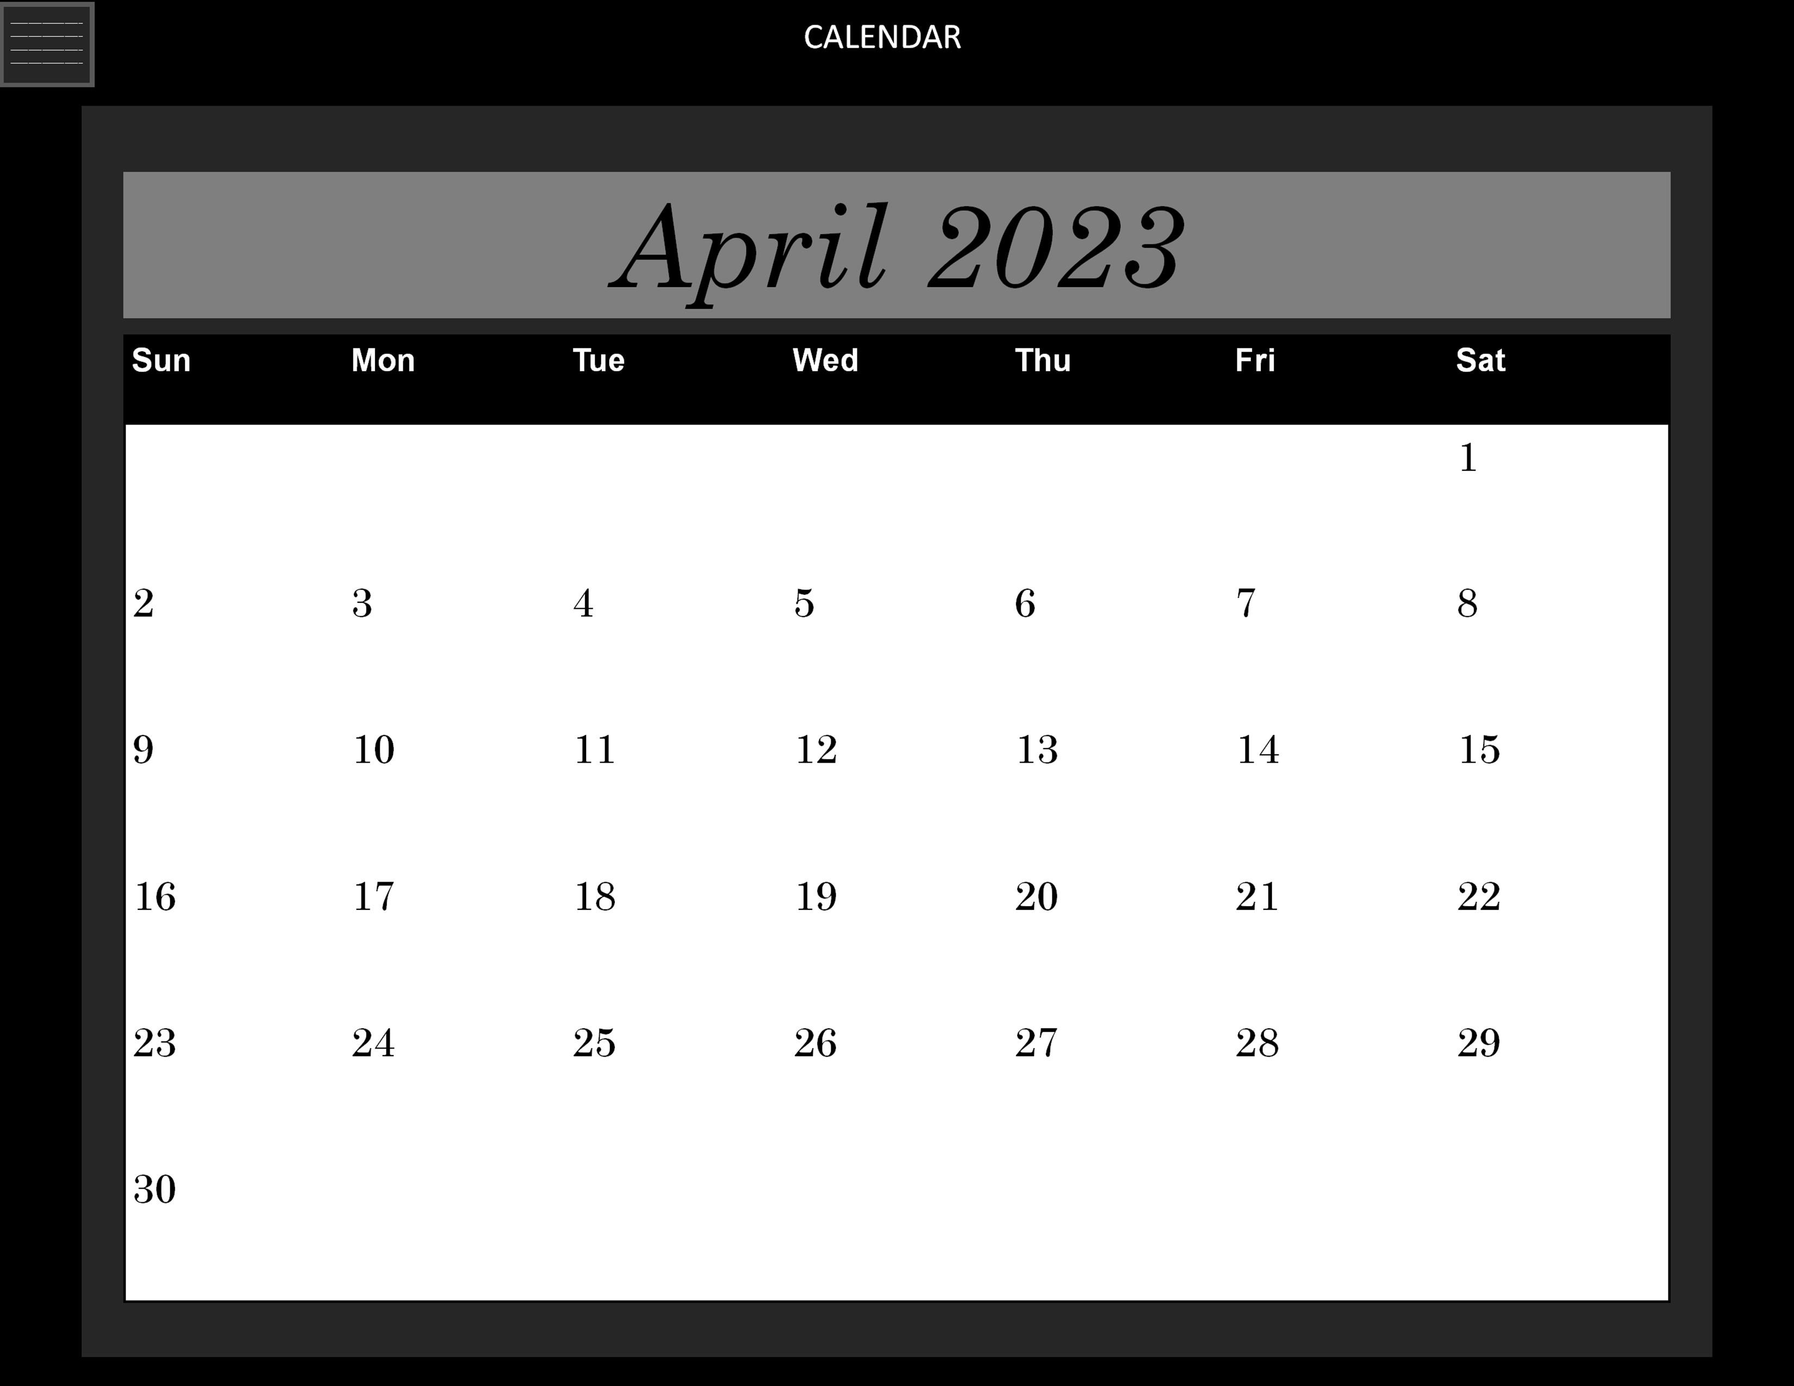
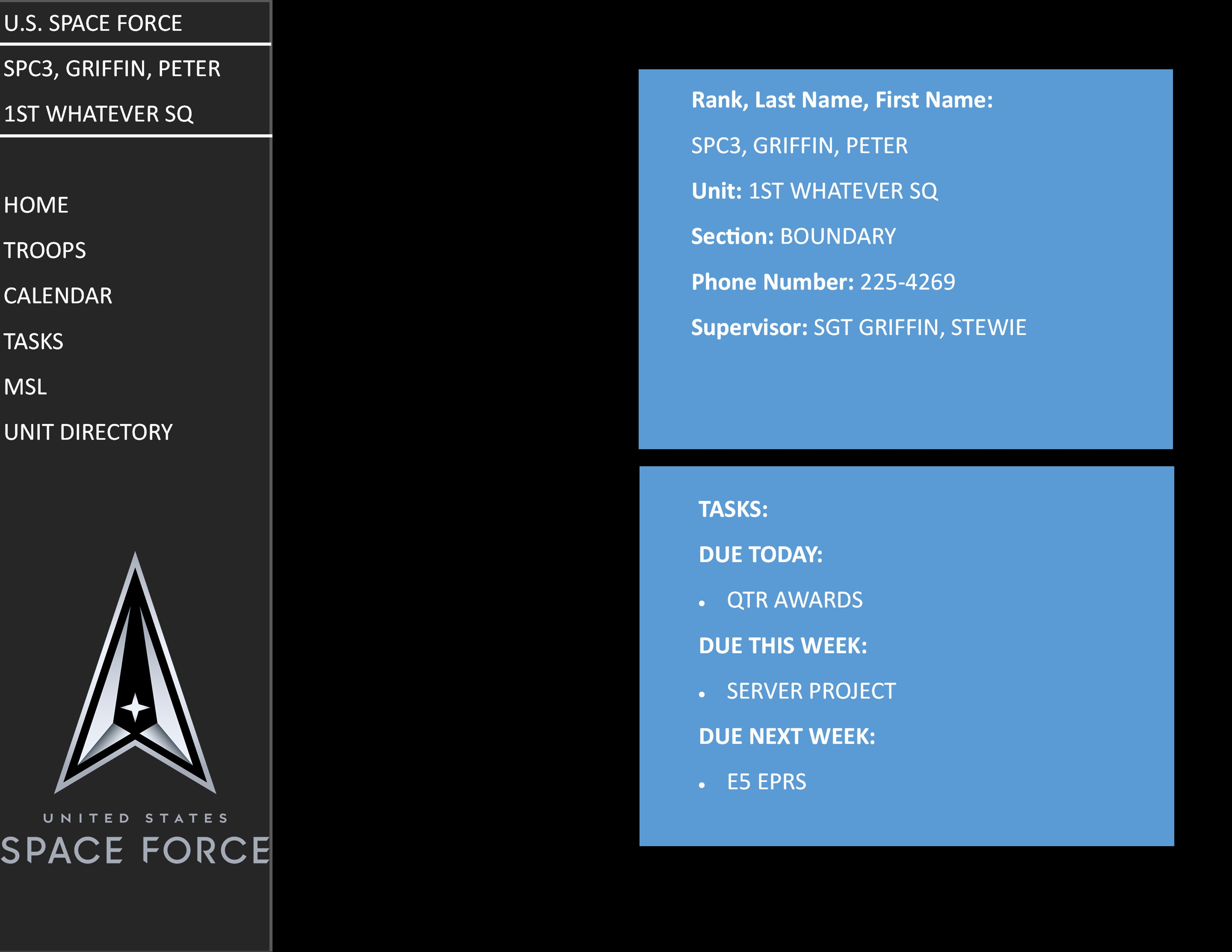
WIREFRAMES
Home page

Slide 4
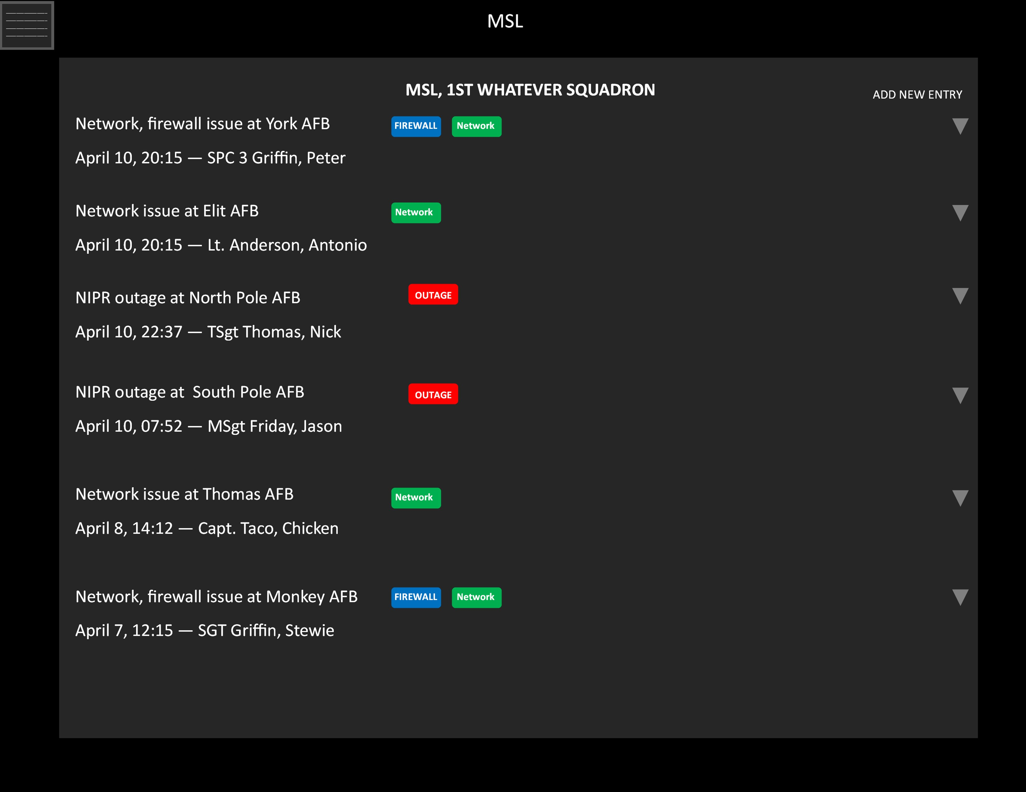
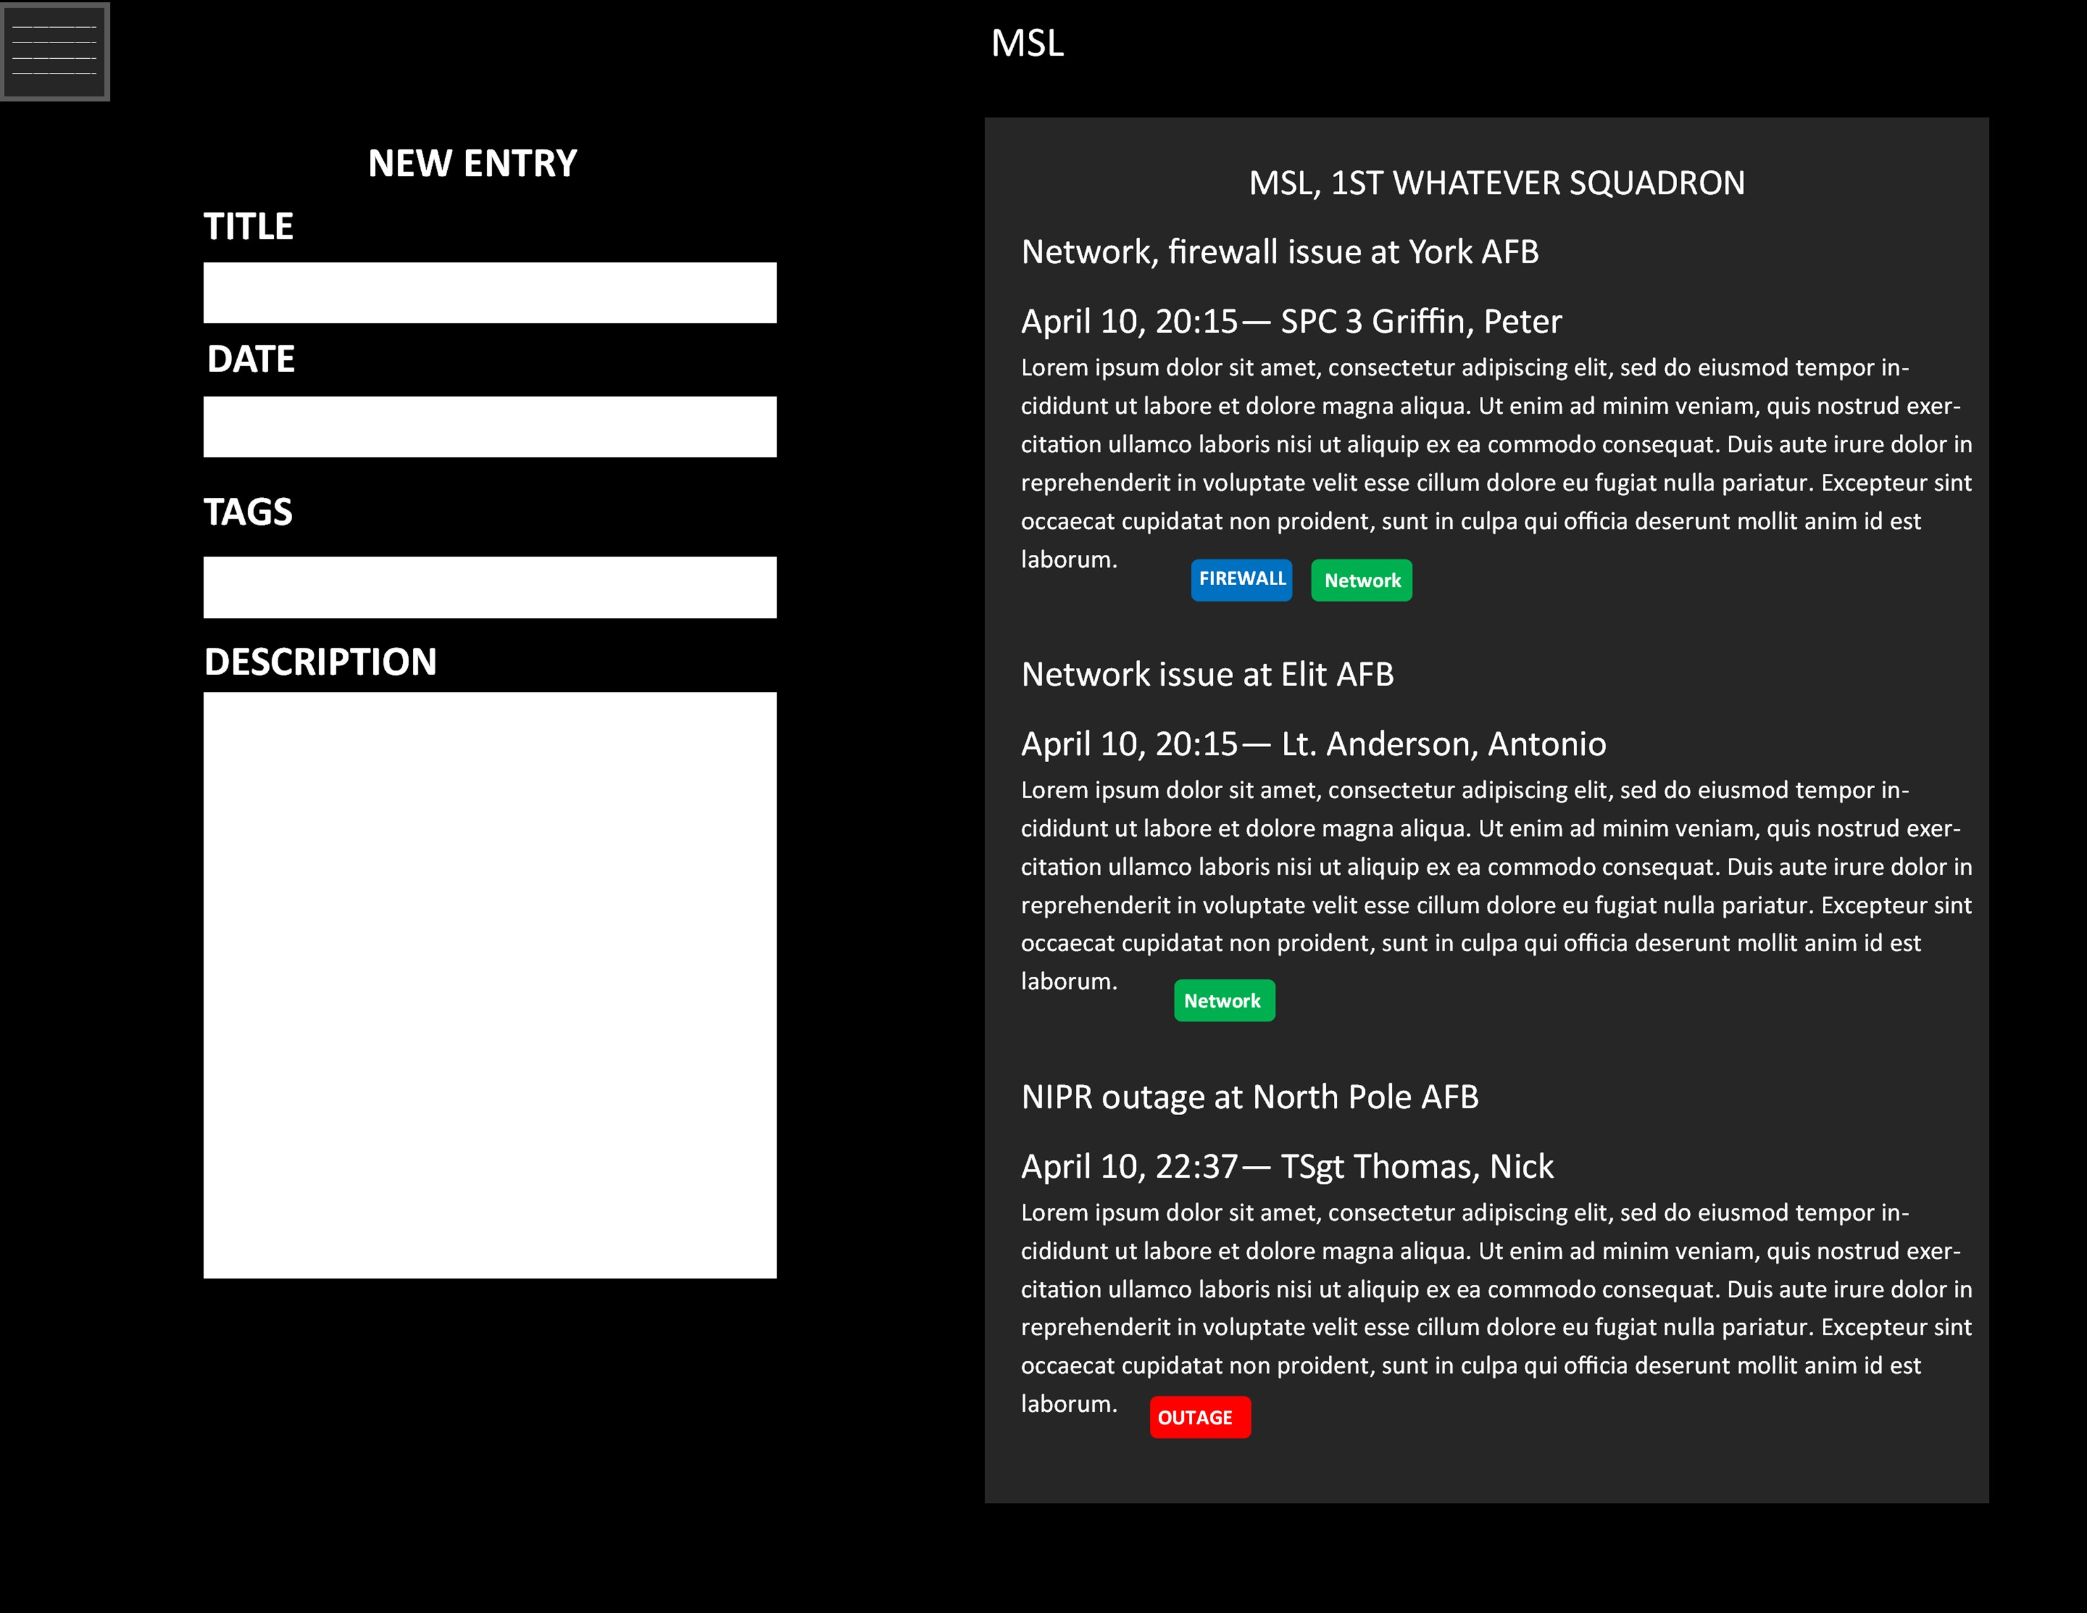
WIREFRAMES

Slide 5
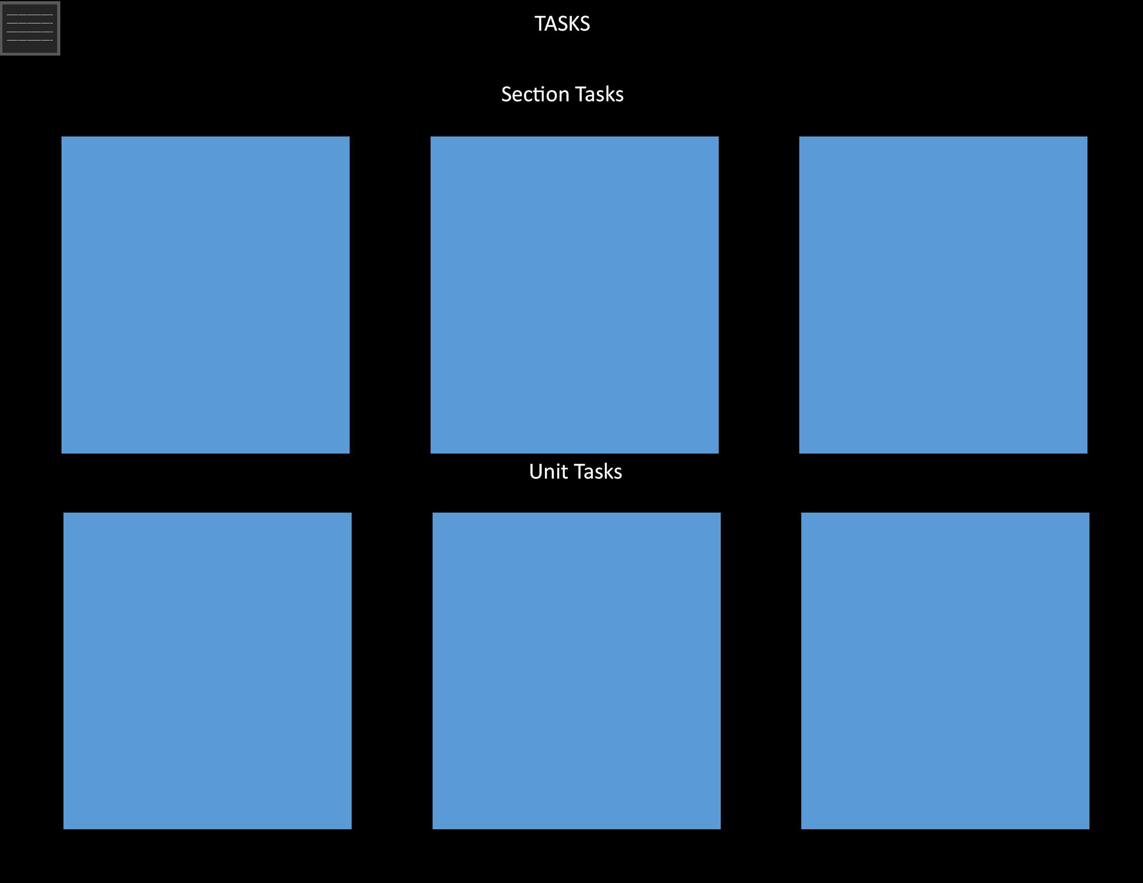
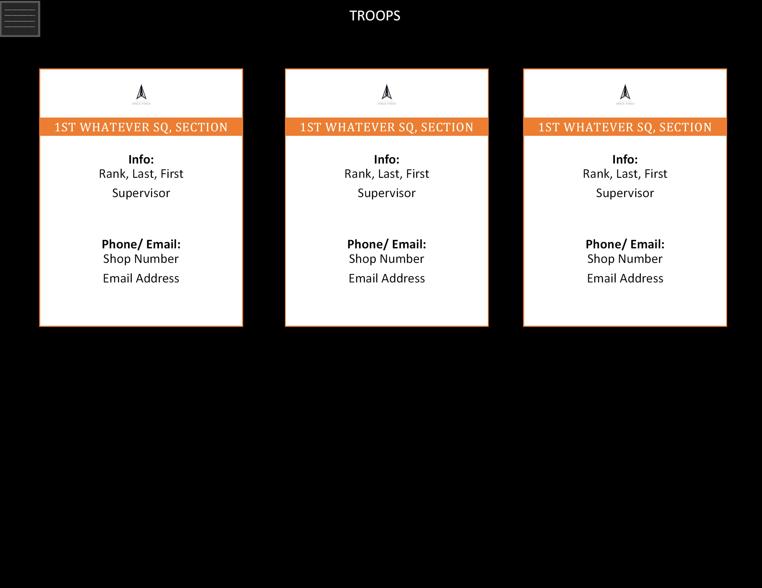
WIREFRAMES

Slide 6
WHAT DID WE LEARN?
We used a mixture of Bootstrap and Tailwind, which towards the end of the project became more Tailwind and less Bootstrap. Tailwind when working properly is super user friendly
Utilizing Sequelize for our ORM instead of Knex
Utilized more semantic HTML tags when appropriate instead of good ol’ <div>
Drag n Drop snapping and tracking is complicated and thought intensive

Slide 7
WHAT DID/DIDN’T GO WELL
Tailwind went very well this time around, unlike project 3….
Utilizing Sequelize for our ORM instead of Knex. The foreign key relations is far more complicated than with Knex, so building extensive tables that rely on each other is very confusing.
Creating a component with TypeScript didn’t go well at first, but we made it work and has been well worth the effort.
Special thanks to Emilio for quick vision on the wireframes and setup of front end

Slide 8
Hardest challenge
A mixture of Sequelize and the drag and drop, due to the finicky nature of both.

Slide 9
If we had more time?
Generate exportable PDF reports for task/admin metrics that can be sent to leadership.
Import PDFs into the site, edit, and then export. Thinking along the lines of 1206s, EPRs etc.

Slide 10
What are we most proud of?
Calendar
Drag and drop
Awards page
Getting Tailwind to work

Slide 11
Time for presentation!

